Slide 1



ABAP on Hana s/4 Hana Training
Day 3
contact@anubhavtrainings.com

Slide 2

Agenda – Day 3
New ABAP Syntax
Inline data declaration
Dynamic memory references
SQL Statement with escaping of host variables
SQL Enhancement
Describe EPM Data Model

Slide 3
New ABAP Language Feature
We have now option to mark host variables in the select query – Escaping of host variable.
01
Now we can use comma separated
fields.
01
We can use Inline data declaration data() , String Expression.
We can use literals inside of sql queries & Arithmetic Operations.
.
02
02
SQL ENHANCHMENT
We can Create object & Value/Constructor Expression.
NEW ABAP SYNTAX
03
We have new SQL functions to perform logic.
03
We use Corresponding # & Table Expression.
04
Case Expression can be added.
04

Slide 4

SQL Enhancement
With the introduction of NW AS ABAP 740 SPS5, the New enhanced extended Open SQL was introduced. The new enhanced open sql has some good features such introduction of aggregate functions, right outer join, casting, etc. making it a starting step for Code-Push down paradigm.
Exercise 1
Learn New ABAP Syntax Code

Slide 5
Describe EPM Data Model
Real-time like demo data model which includes database tables, FMs, classes, Scenarios for training purpose and very much similar to real-life.
Products
Texts
Purchase Order Header
Items
100 Laptops
300 HDD
50 Projectors
….
Sales Order Header
Items
10 Laptops
3 HDD
5 Projectors
ITeIO
Electronics goods supplier (Amazon)
Customers (BP)
Suppliers (BP)
Invoice
Invoice Items
6 laptop
3 HDD
2 Projector
Stock
Invoice Line Item <= Sales Order Line item
6 laptop
3 HDD
2 Projector

Slide 6

Tables of EPM
SNWD_PD – Products
SNWD_TEXTS – Product Descriptions
SNWD_BPA – Business Partners
SNWD_AD – BP Addresses
SNWD_SO – Sales orders
SNWD_SO_I – Sales Order Items
SNWD_SO_INV_HEAD – Invoice header
SNWD_SO_INV_ITEMS – Invoice items
….

Slide 7
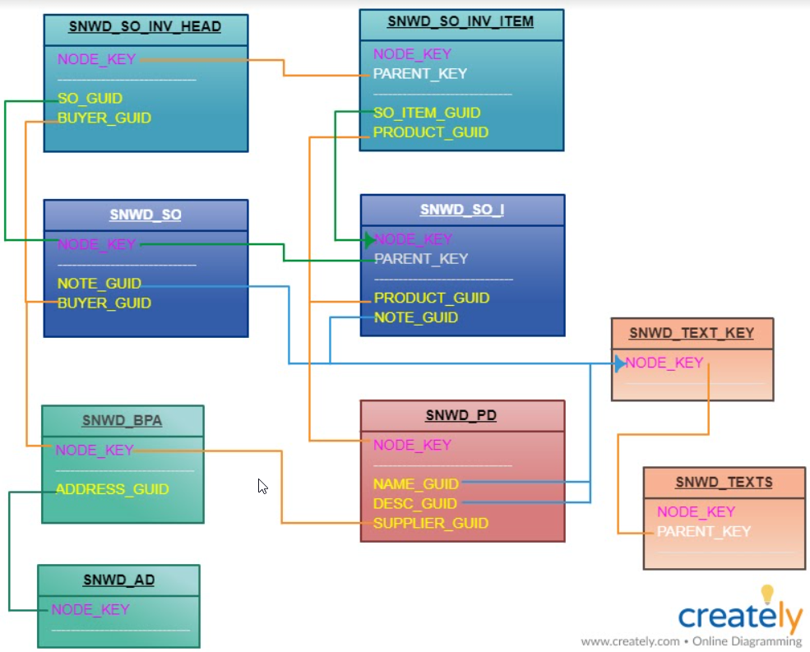
Database Design for EPM Model

Slide 8

End of Day 3
Trainer: Anubhav Oberoy & Shubham Singh

Slide 9

Trainer: Anubhav Oberoy & Shubham Singh

Slide 10
THANK YOU
If you cannot do
great things, do small things in a great way.
Anubhav Oberoy & Shubham Singh
https://www.anubhavtrainings.com

Slide 11


We’re committed to empower you to be
Most Desirable Resource
through powerful training solutions.
We build the workforce of the future.
250+
Corporate Clients
30,000+
Learners Trained
25000+
Learners Placed
FREE WEBINARS
Sign up for free webinars with industry experts every fortnight!
Enroll Now!
Contact us today!
https://anubhavtrainings.com/

Slide 12




More from AnubhavTrainings.com

